Slide 1
Creditor control rights and resource allocation within firms
Nuri Ersahin
Broad College of Business, Michigan State University
Rustom M. Irani
Gies College of Business, University of Illinois at Urbana-Champaign
Hanh Le
College of Business, University of Illinois at Chicago
Journal of Financial Economics
July 2020
Presented by: Yan Li

Slide 2
Research Goal:
Examine the within-firm resource allocation and restructuring outcomes at firms violating debt covenants

Slide 3
Data sources
The Census: establishment-level data
the Longitudinal Business Database (LBD): longitudinal identifiers as well as data on the number of employees, payroll, location, and industry for each establishment. The LBD also records corporate affiliation, allowing us to identify establishment closures.
The Census of Manufactures (CMF) and Annual Survey of Manufactures (ASM): greater detail on activities for the subset of manufacturing establishments. It provides information on industry, corporate affiliation, output (total value of shipments), employment, capital expenditures, and material inputs of each establishment.
Compustat: firm-level data including balance sheet and income statement data
Nini et al. (2012): financial covenant violations
Dealscan database: a large sample of loan contracts, including detailed information on maintenance covenants based on accounting ratios

Slide 4
Sample
Sample: 21,0 0 0 firm-year observations covering approximately 2,0 0 0,0 0 0 establishment-years
Sample period: 1996 to 2009

Slide 5
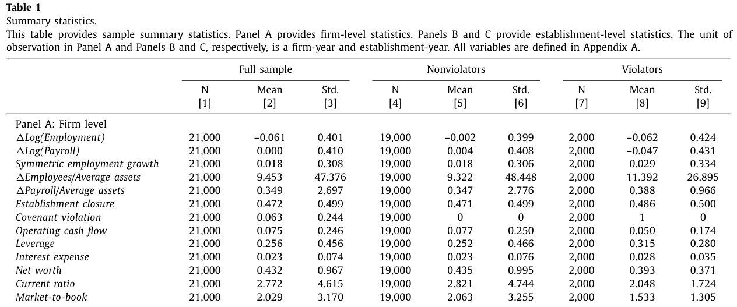
Variable construction and summary statistics
The change in employment is larger for violators both at the firm and establishment levels
Significant performance differences: violators have lower net worth, current ratio, and market- to-book ratio; hold less cash; and are more levered.

Slide 6
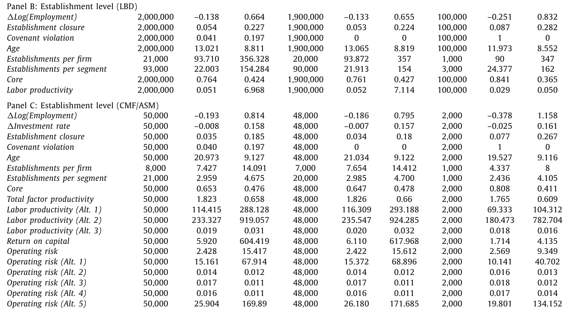
Variable construction and summary statistics
The rate of covenant violations is about the same for manufacturing (0.040) compared with all other establishments (0.041).
Establishments belonging to violating firms experience closures with greater frequency

Slide 7

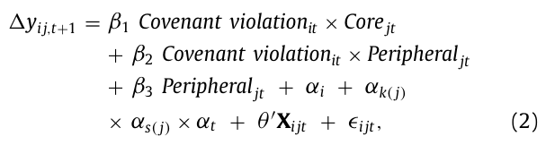
Identification and empirical model
∆y_{i,t+1} , captures resource allocation with either the within-firm annual change in the natural logarithm of the number of employees or in the establishment closure rate. α_{t} and α_{k} denote year and industry fixed effects. X_{it} contains a list of firm-level controls
∆y_{ij,t+1} , is the within- establishment annual change in resource allocation
α_{i} and α_{k ( j )} × α_{s ( j )} × α_{t} denote firm and industry-by-state-by-year (of the establishment) fixed effects

Slide 8
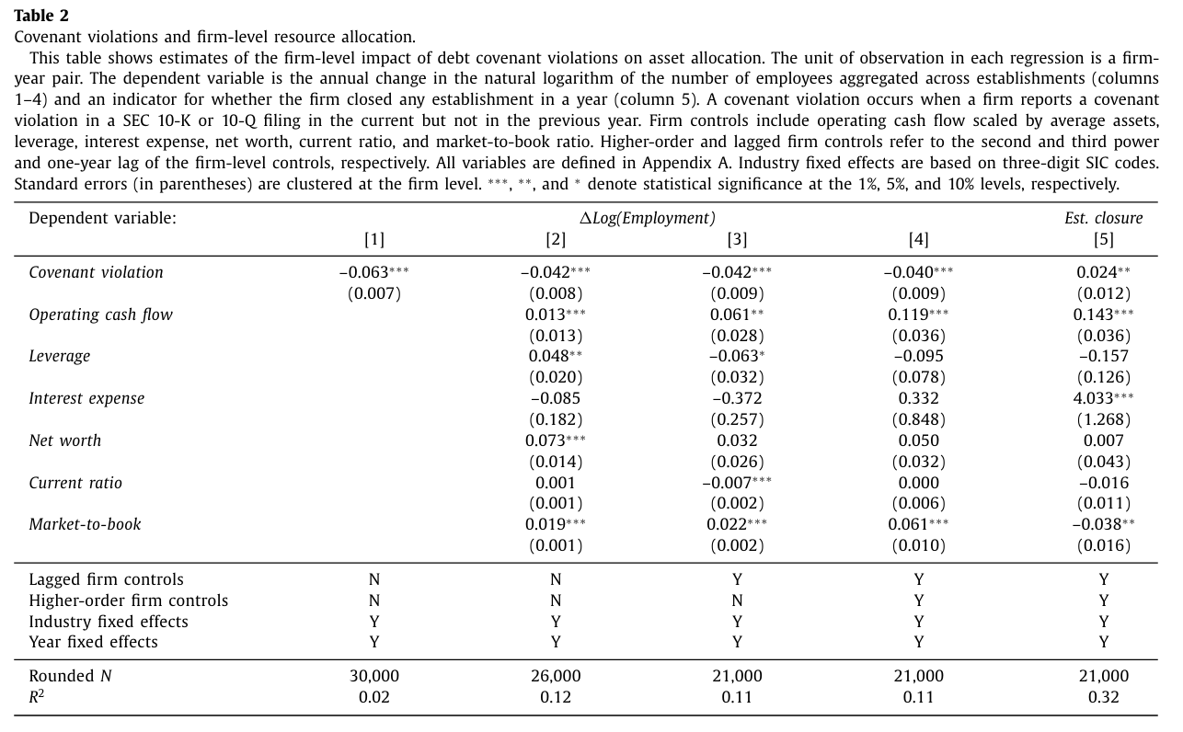
Empirical results
Covenant violations induce firms to lay off employees
Covenant violations also lead firms to withdraw resources on a larger scale through establishment closures.

Slide 9
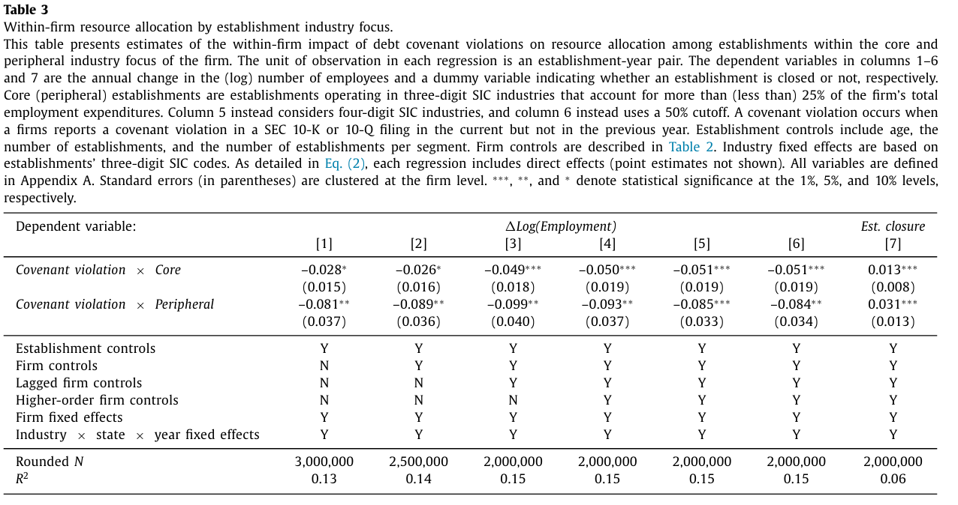
Establishments operating in core and peripheral business lines
In columns 1–4 : firms decrease employment significantly at both core and peripheral establishments, but the effect is about twice as large at peripheral establishments.
Column 5 & 6: Robustness: Column 5 with 4-digit SIC codes and maintain the 25% threshold; column 6 uses 3-digit SIC codes and 50% payroll threshold
The coefficients of closure are significantly positive for both types of establishment, but the coefficient for peripheral establishments is much larger (0.013 versus 0.031)

Slide 10
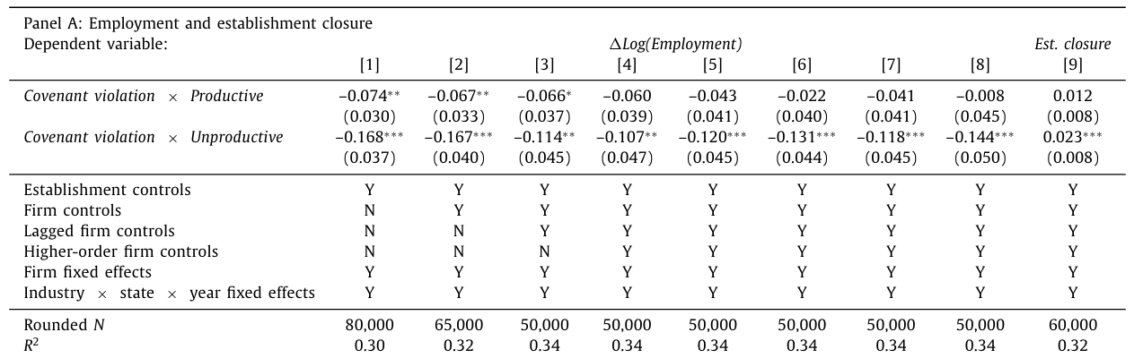
Establishment productivity
Productive (unproductive) establishments fall above (below) the median of TFP of the establishments belonging to the same firm
Alternative Productivity measure:
column 5 within-industry TFP ranking of establishments
Column 6, value added per labor hr
column 7, output divided by total labor hours
In column 4, with the full set of controls, layoffs at productive establishments are indistinguishable from zero. In contrast, unproductive establishments experience employment cuts that are large and statistically significant at the 1% level.

Slide 11
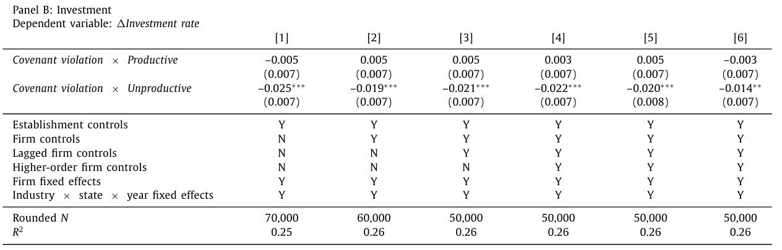
Establishment productivity
within-firm TFP ranking (columns 1–4)
within-industry TFP ranking (column 5)
In column 6 we proxy for capital productivity based on return on capital (ROC)
Following covenant violations, violating firms incrementally cut investment by between 1.9 and 2.5 percentage points at unproductive establishments. Productive establishments are not affected.

Slide 12
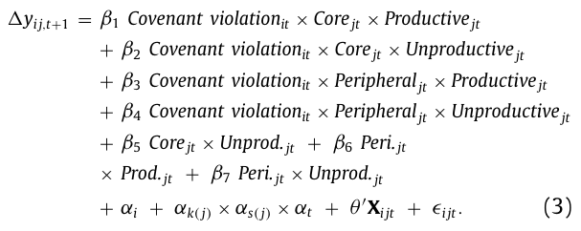
Establishment industry focus and productivity
Interaction: violation with focus and productivity

Slide 13
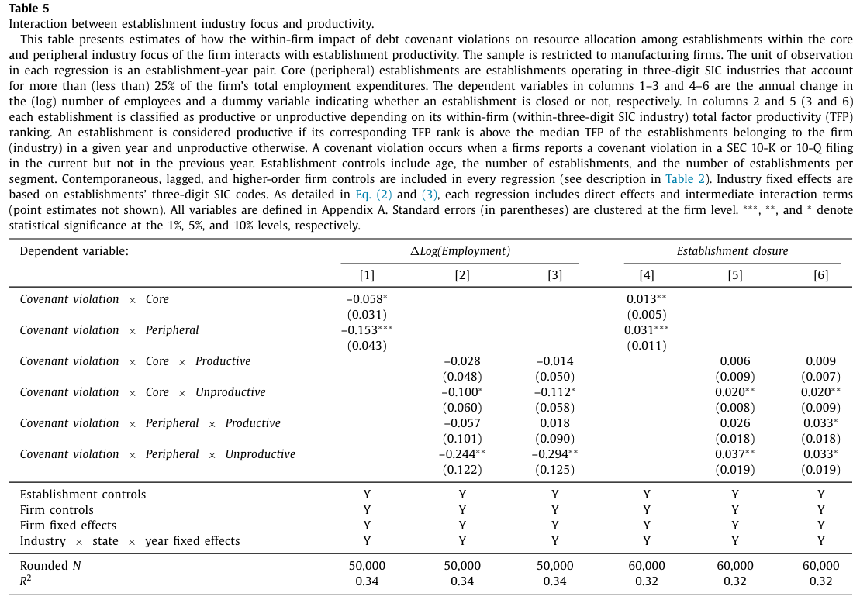
Establishment industry focus and productivity
the cuts occurring at manufacturing establishments outside of the core focus of violating firms are in line with the estimates for all industries (see Table 3 )
on the interaction between focus and productivity, we see that the cuts occur among unproductive establishments in both core and peripheral industries; however, they are far larger in magnitude at the peripheral establishments

Slide 14
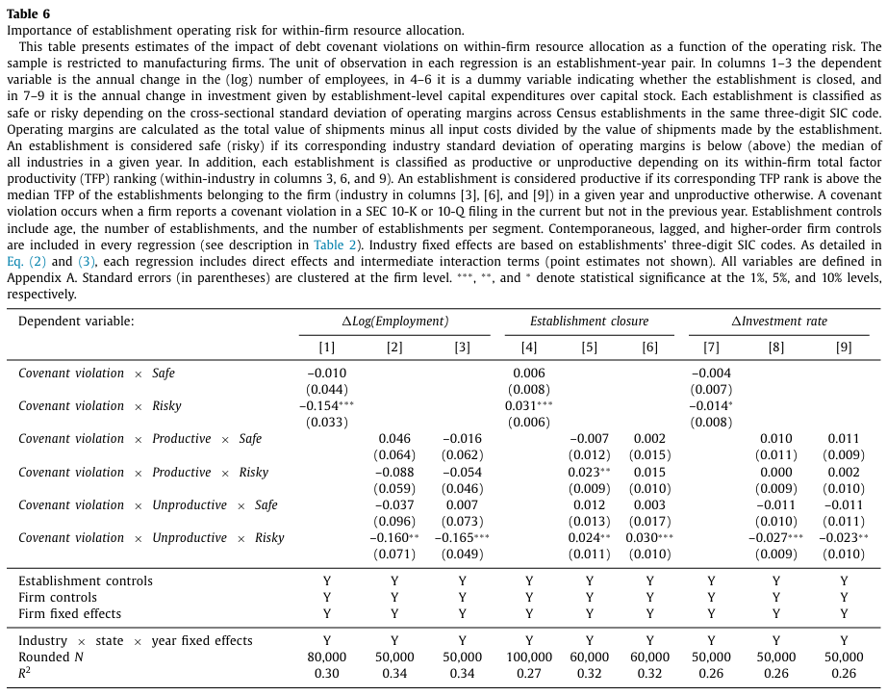
Establishment operating risk
layoffs are present only at risky establishments.
a higher incidence of closures and large cuts occur in investment among risky establishments only.
Column 2: within-firm
Column 3: within- industry
layoffs are concentrated among the establishments that are considered to be both unproductive and risky

Slide 15
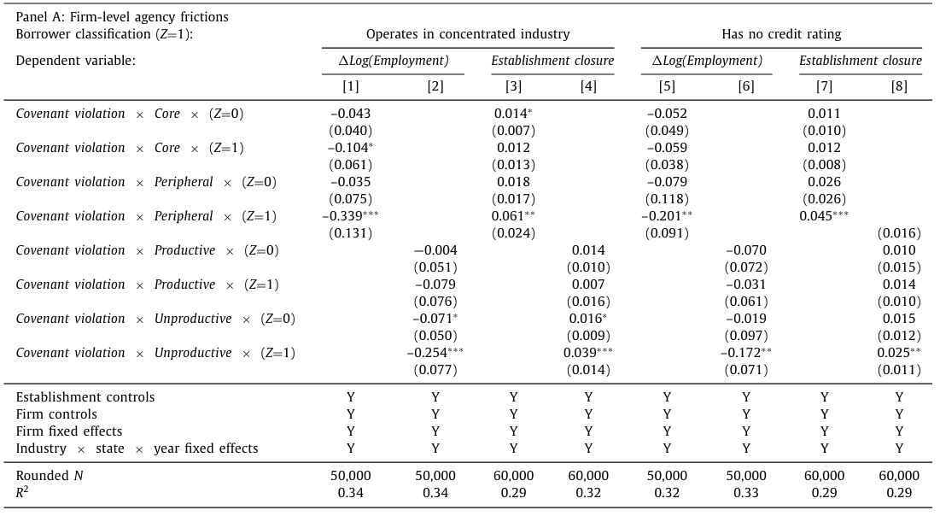
Heterogeneity among borrowers
There’s a shift in resources away from peripheral and unproductive establishments operating in concentrated industries and
among firms without a credit rating.

Slide 16
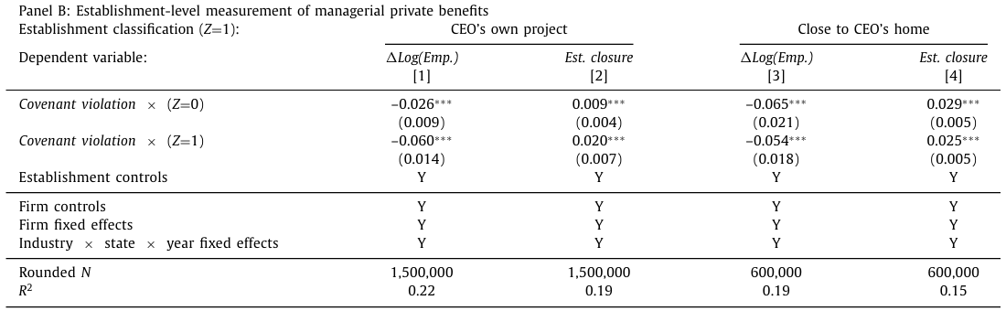
Heterogeneity among borrowers
The incremental effect of the covenant violation on resource withdrawals— employment cutbacks and establishment closures—is about twice as large for projects launched during the tenure of the CEO
Establishments both close to and far from the CEO’s home county experience an increase in closures and employment cutbacks.
The results are therefore consistent with the state-contingent shift in control from managers to creditors leading to a reduction in investments that are more likely to be motivated by manager-shareholder agency conflicts.

Slide 17
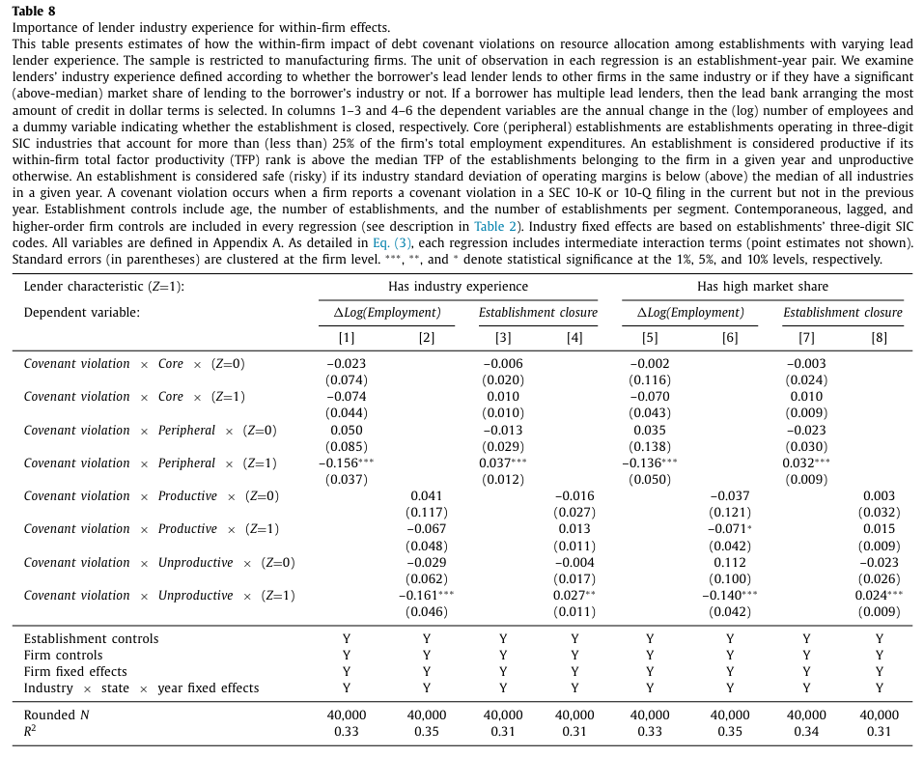
Heterogeneity among lenders
Only those firms whose main lender has industry experience exhibit allocation effects that are consistent with operational improvements − employment cutbacks and establishment closure

Slide 18
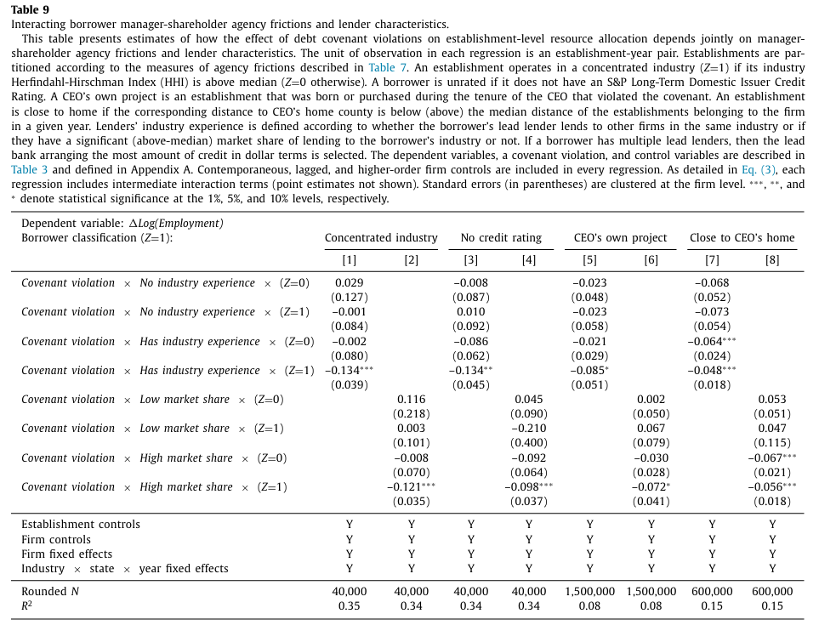
Heterogeneity among lenders
Following covenant violations, cutbacks occur at establishments prone to manager-shareholder agency problems predominantly when lenders have greater industry experience
Similar results emerge for unrated firms as well as establishments classified as CEO’s own projects or close to the CEO’s hometown

Slide 19
Conclusions
Covenant violations are followed by significant cutbacks, about 5% of the labor force.
Two patterns of within-firm resource allocation following covenant violations: withdraw resources significantly more from peripheral establishments; pull resources entirely at unproductive establishments.
These changes are prominent when key lenders specialize in a borrower’s industry, which is consistent with creditors valuing relationships and offering expertise and knowledge when advising management through difficult times
These findings fit with the view that creditors can alleviate manager- shareholder agency costs and thereby play a positive role in the corporate governance of underperforming firms

Slide 20
Marginal Contributions to Literature
Our findings contribute to empirical research on the importance of creditors in corporate governance, which builds on theoretical work analyzing optimal debt contracting in the presence of agency problems
Our paper provides novel evidence of a mechanism that is consistent with this positive role of creditors among underperforming firms: the way resources are allocated within firm boundaries.
We identify sources of efficiency gains that resemble those associated with major equity-centered governance interventions, notably mergers and acquisitions ( Li, 2013; Maksimovic et al., 2011 ), private equity (PE) transactions ( Davis et al., 2014 ), and hedge fund activism ( Brav et al., 2015 ).
Our paper relates to the literature on creditor rights and firm outcomes, including risk-taking.

